Slide 1
.
Been For Your 60,000 Mile Check-up Lately?
.

Slide 2
MOTIVATION
Been For Your 60,000 Mile
Check-up Lately?

Slide 3
THE HIGHER EDUCATION
BACKGROUND
Shrinking budgets
Reductions in staffing
Declining state support (public institutions)
Eroding endowments (both public and private schools)
Dramatically increasing tuition and/or fees
Greater competition
Increasing costs of educating students
Been For Your 60,000 Mile
Check-up Lately?

Slide 4
THE HIGHER EDUCATION
BACKGROUND
Shrinking budgets
Reductions in staffing
Declining state support (public institutions)
Eroding endowments (both public and private schools)
Dramatically increasing tuition and/or fees
Greater competition
Increasing costs of educating students
MORE WITH LESS!!
Been For Your 60,000 Mile
Check-up Lately?

Slide 5
MOTIVATION
Been For Your 60,000 Mile
Check-up Lately?

Slide 6
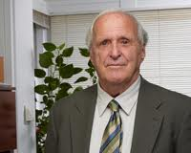
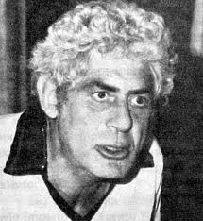
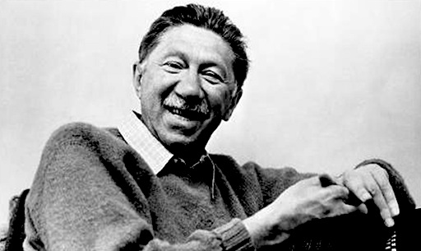
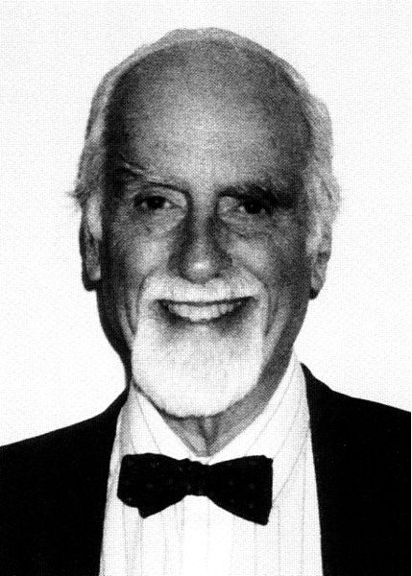
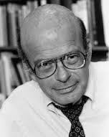
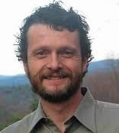
MOTIVATION
Been For Your 60,000 Mile
Check-up Lately?

Slide 7
MOTIVATION
Been For Your 60,000 Mile
Check-up Lately?

Slide 8
MOTIVATION
Been For Your 60,000 Mile
Check-up Lately?

Slide 9
MOTIVATION
$461,983,149.00 (just in 2006)
Been For Your 60,000 Mile
Check-up Lately?

Slide 10
MOTIVATION
Been For Your 60,000 Mile
Check-up Lately?

Slide 11
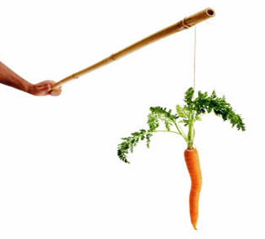
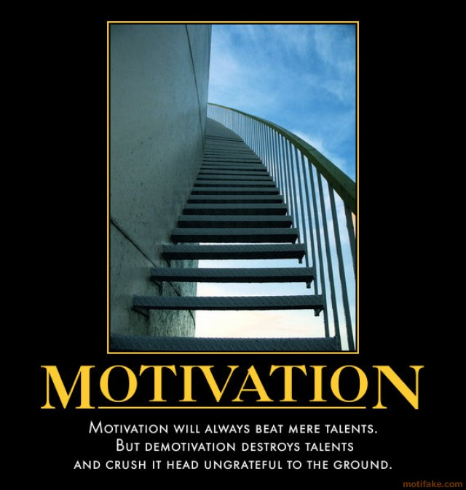
MOTIVATION
Been For Your 60,000 Mile
Check-up Lately?

Slide 12
MOTIVATION
The process that initiates, guides and maintains goal-oriented behaviors
Been For Your 60,000 Mile
Check-up Lately?

Slide 13
MOTIVATION
The process that initiates, guides and
maintains goal-oriented behaviors
Activation
Persistence
Intensity
Been For Your 60,000 Mile
Check-up Lately?

Slide 14
MOTIVATION
The process that initiates, guides and
maintains goal-oriented behaviors
Activation
Persistence
Intensity
Motivation = Efficiency
Hawthorne Studies and the Hawthorne Effect
Been For Your 60,000 Mile
Check-up Lately?

Slide 15
MOTIVATION
The process that initiates, guides and
maintains goal-oriented behaviors
Motivation = Efficiency
Activation
Persistence
Intensity
Motivation = Needs and Drives
Ok, but limited applicability to everyday life
Been For Your 60,000 Mile
Check-up Lately?

Slide 16
MOTIVATION
The process that initiates, guides and
maintains goal-oriented behaviors
Motivation = Efficiency
Activation
Persistence
Intensity
(Motivation = Needs and Drives)
Motivation = Incentives or Reinforcement
We often act in ways that contradict what we’ve previously experienced
Been For Your 60,000 Mile
Check-up Lately?

Slide 17
MOTIVATION
The process that initiates, guides and
maintains goal-oriented behaviors
Motivation Efficiency
Activation
Persistence
Intensity
(Motivation = Needs and Drives)
(Motivation = Incentives or Reinforcement)
Motivation = Expectations
Rosenhan Experiment
Been For Your 60,000 Mile
Check-up Lately?

Slide 18
MOTIVATION
The process that initiates, guides and
maintains goal-oriented behaviors
Motivation Efficiency
Activation
Persistence
Intensity
(Motivation ~ Needs and Drives)
(Motivation ~ Incentives or Reinforcement)
(Motivation ~ Expectations)
Motivation = Hierarchy of Needs
Maslow and the Humanists
Been For Your 60,000 Mile
Check-up Lately?

Slide 19
MOTIVATION
The process that initiates, guides and
maintains goal-oriented behaviors
Motivation Efficiency
Activation
Persistence
Intensity
(Motivation ~ Needs and Drives)
(Motivation ~ Incentives or Reinforcement)
(Motivation ~ Expectations)
(Motivation ~ Hierarchy of Needs)
Motivation = Perceived Meaning
Daniel Pink and others
Been For Your 60,000 Mile
Check-up Lately?

Slide 20
Motivation as Meaning
Meaning as Story
Been For Your 60,000 Mile
Check-up Lately?

Slide 21
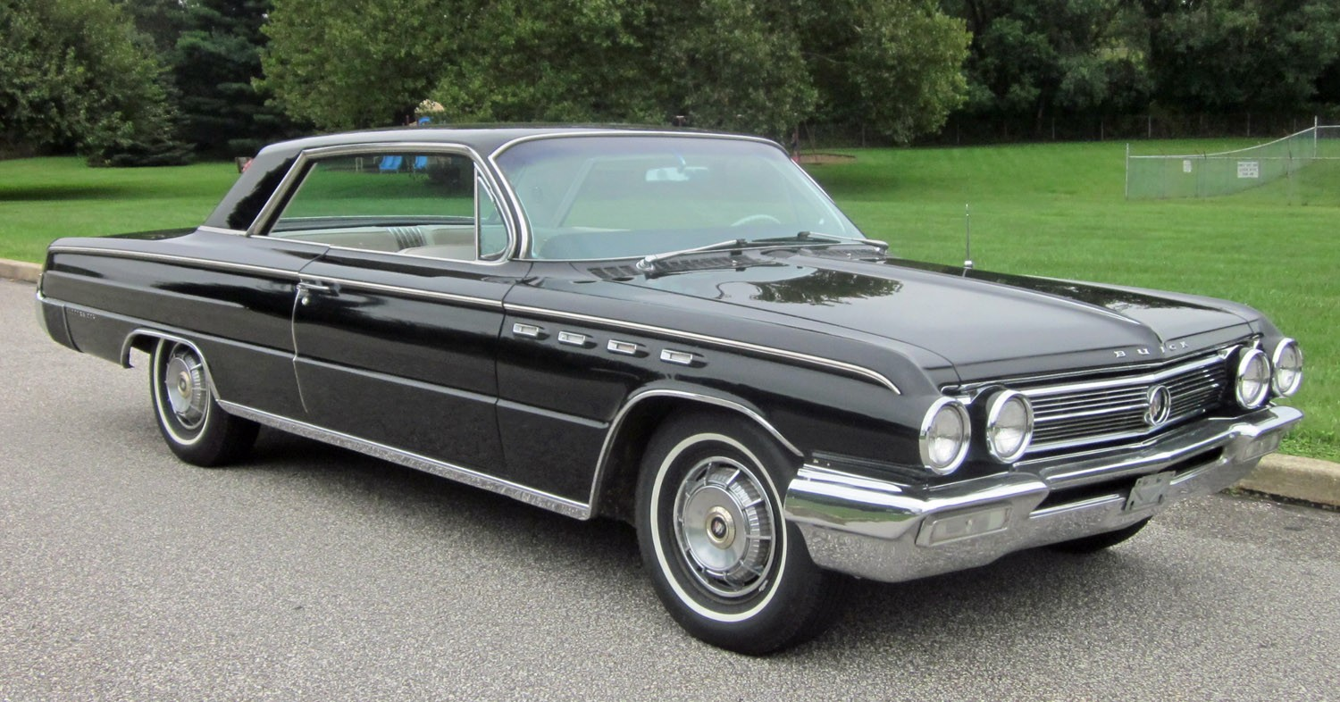
Motivation as Meaning
Meaning as Story
Been For Your 60,000 Mile
Check-up Lately?

Slide 22
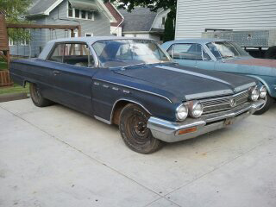
Motivation as Meaning
Meaning as Story
Been For Your 60,000 Mile
Check-up Lately?

Slide 23
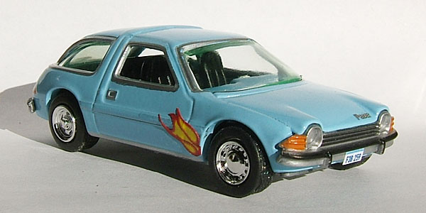
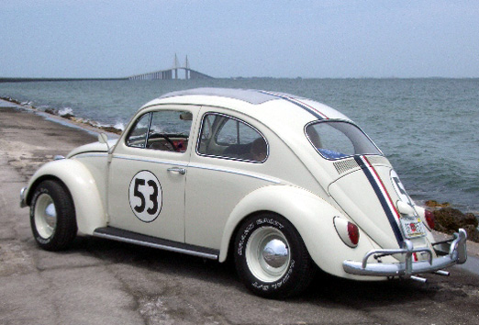
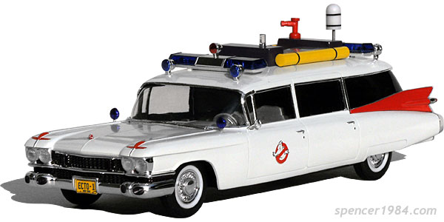
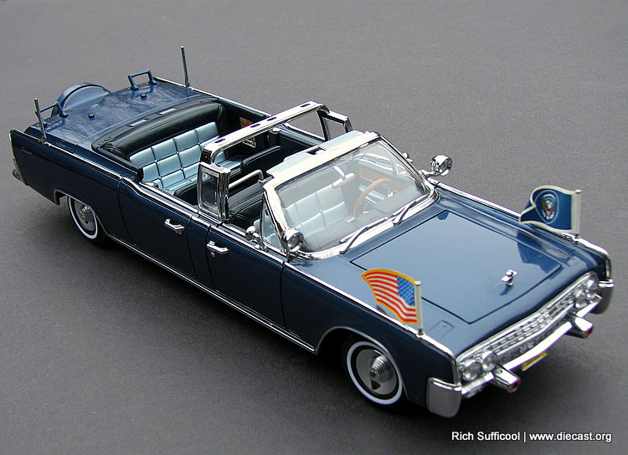
Motivation as Meaning
Meaning as Story
Ever name your car?
When has your car broken down?
ROADTRIP!!!
Ever experience a right-of-passage in a car?
What’s the care you’d rather have?
Pedittle!!
Favorite driving song?
Ever sing in the car?
Been For Your 60,000 Mile
Check-up Lately?

Slide 24
Motivation as Meaning
Meaning as Story
What are the stories we tell about our work?
Who are the characters?
How are we changing lives?
What do these images mean to our campuses?
Been For Your 60,000 Mile
Check-up Lately?

Slide 25
Motivation as Meaning
Meaning as Story
Borrowing from Dan Ariely:
Why do people seek to summit mountains?
The Bionicles study– perceiving results of our effort
The double letter study – perceiving that our effort is valued
The origami study – challenge (effort put in) yields value of the product
The call center study – understanding how others benefit (Grant)
The mock interview study – the power of positive feedback
The baby animals effect – performance and positive thoughts
Stereotype Threat – how perceived threat impedes
performance (Steele)
Been For Your 60,000 Mile
Check-up Lately?

Slide 26
Creating Story For Yourself and Others at Work
Institution
Unit
Supervisor
Employee
Student
Perspective Applicant
External
Internal
Been For Your 60,000 Mile
Check-up Lately?

Slide 27
Creating Story For Yourself and Others at Work
Institution
Unit
Supervisor
Employee
Student
Perspective Applicant
Mission
Vision
Eliciting Story
Values Culture
External
Internal
Telling Story
Managing up
Listening
Search for Meaning
Been For Your 60,000 Mile
Check-up Lately?

Slide 28
MOTIVATION
Quick personal aside….
Been For Your 60,000 Mile
Check-up Lately?

Slide 29
MOTIVATION
In the final analysis….
How people drive to work….
A word about Victor Vroom – expectancy theory
A bit of meaning….
Been For Your 60,000 Mile
Check-up Lately?

Slide 30
.
Questions?
How can I help?
.
Grant Kollet
University of Washington
First Year Programs
grantk3@uw.edu
206.543.9022

